Slide 1
GRIEVANCE AND APPEALS

Slide 2
Appeals – The members request for Gainwell’s review of an adverse benefit determination. Grievances - The member’s expression of dissatisfaction about any matter other than an adverse benefit determination. **NOTE- we do not ask a member if they want to file a grievance. When you hear they are unhappy about something you file the grievance.
Definitions

Slide 3
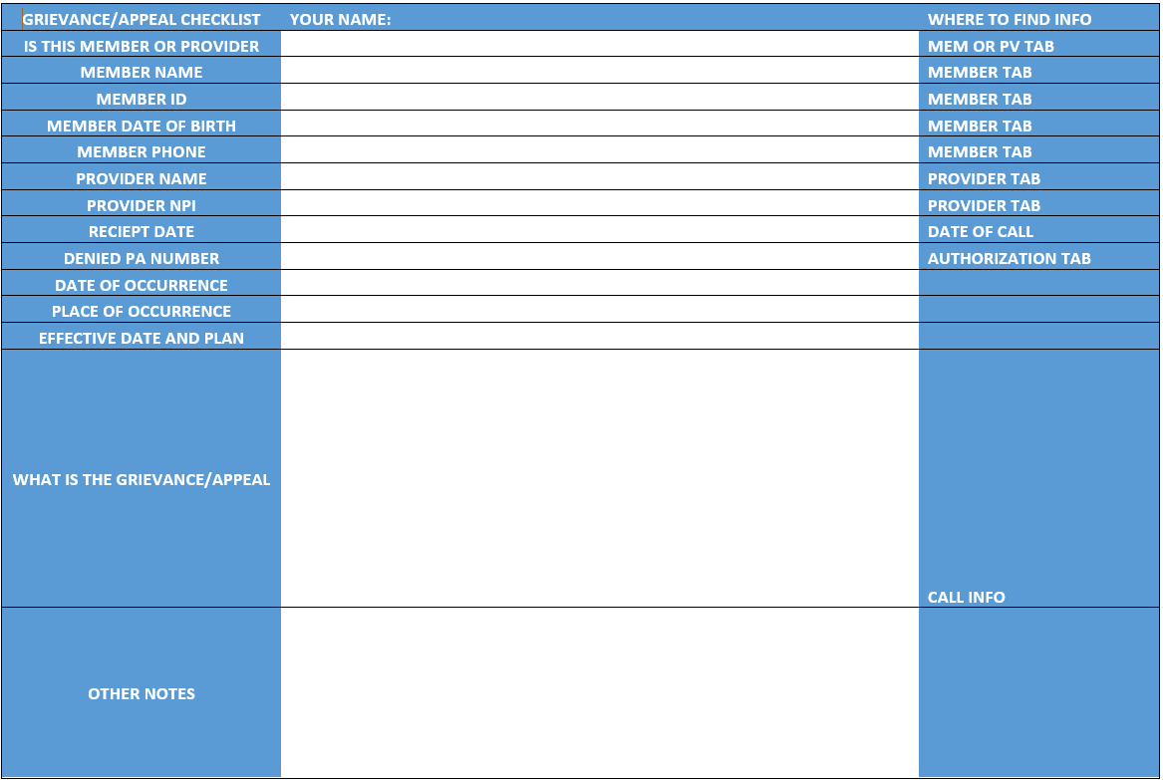
Grievance and Appeals Template
This is the form that you will use when a member calls in and expresses their desire to file either a Grievance or Appeal. This form will be sent to you along with the presentation. **It is extremely important that you include your name in case there are questions.

Slide 4
You will complete this form a thoroughly as possible. Then you will print to your computer with the below directions.

Slide 5
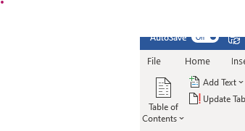
How to use Grievance Template
Fill in as much information in the template as possible. There must be member name, ID and the Grievance issue.
Once you have completed it, print the file as a PDF on your computer. The easiest way is to make a folder and just put them in there. You do this as follows:
At top of form select file

Slide 6
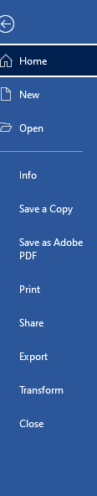
2. Click Print

Slide 7
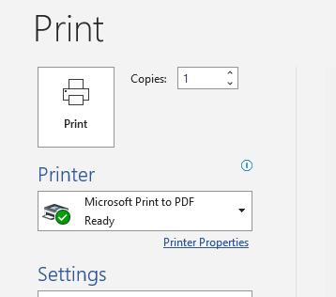
3. Make sure Printer is set to Microsoft Print to PDF and then click the Printer Icon

Slide 8
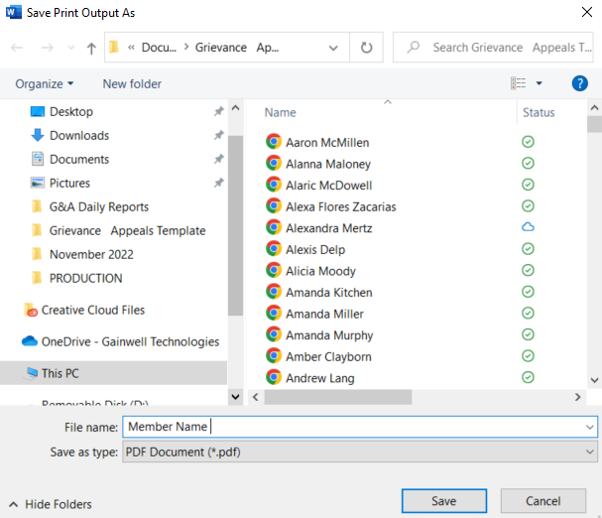
4. Select the folder you want to save the print to.
5. Name your file your member’s name
6. Click Save

Slide 9
Next go back to VUE360Rx

Slide 10
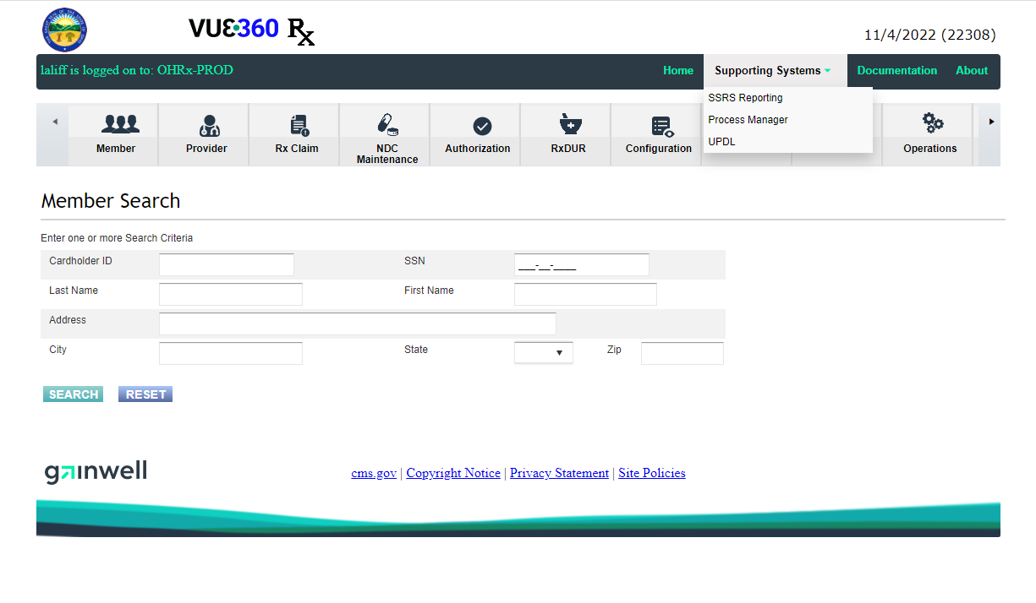
From Supporting Systems select Process Manager

Slide 11
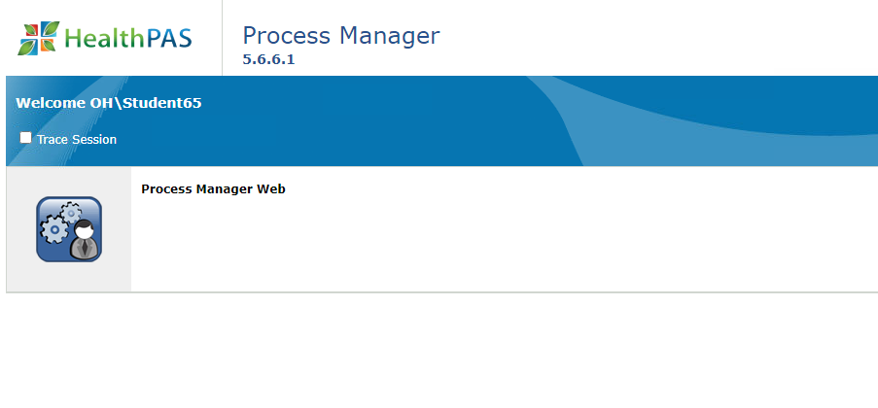
To access Process Manager, click on the little man beside the gears.

Slide 12
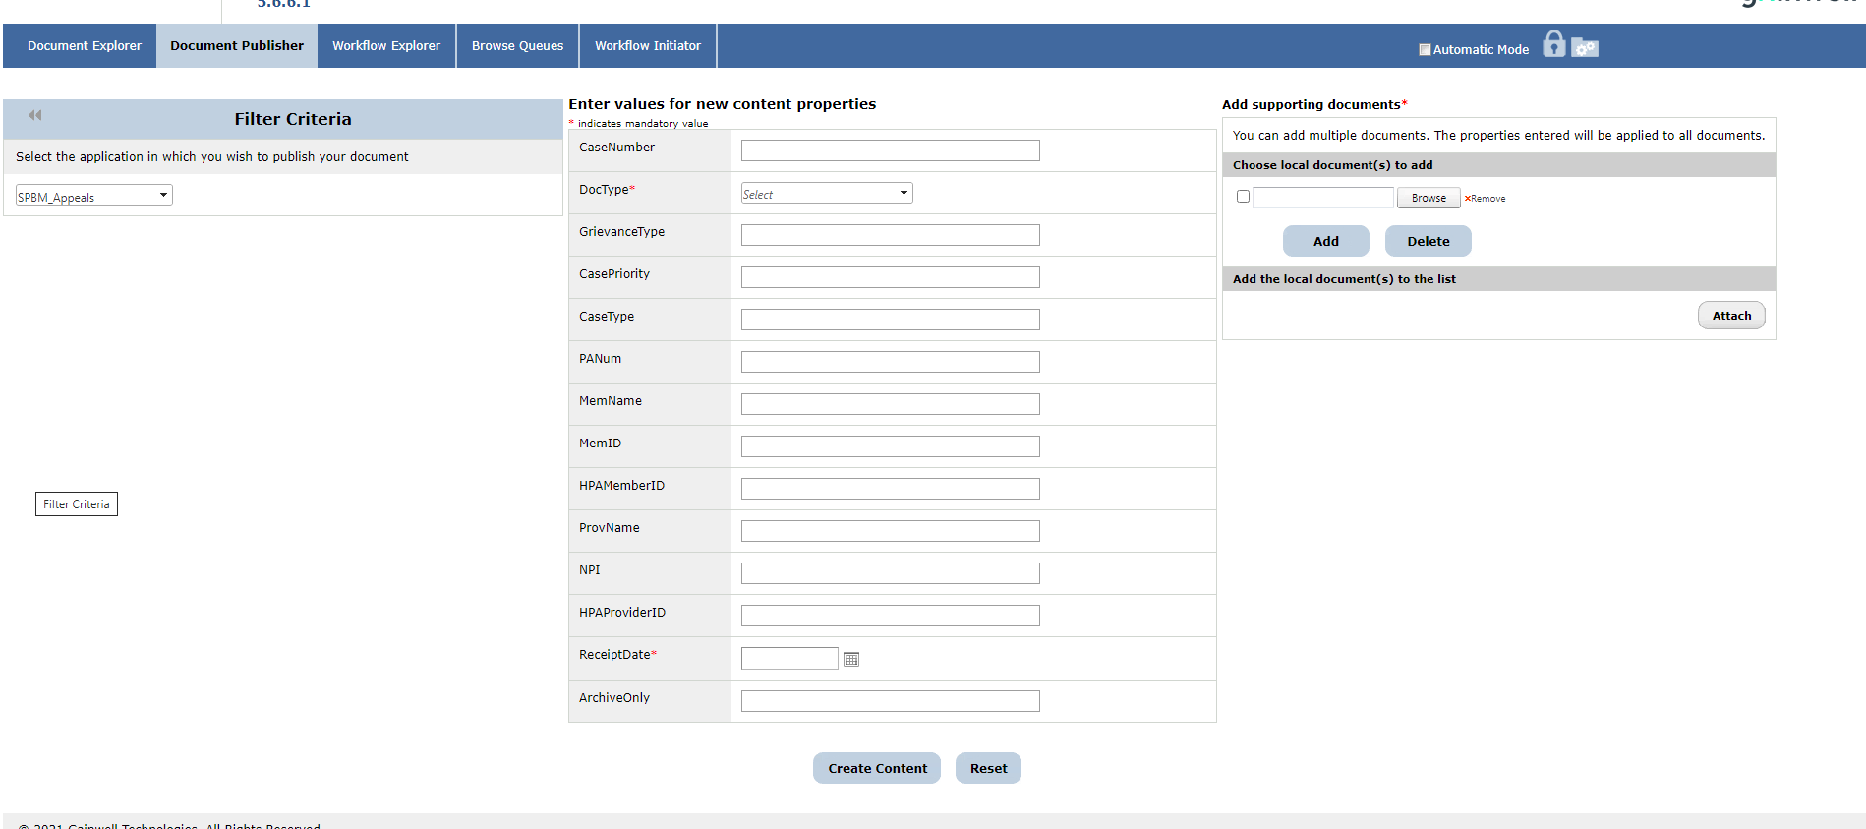
Click on the Document Publisher tab to enter your information from the Grievance and Appeals Template.
IMPORTANT- NEVER ENTER ANYTHING IN THE CASE NUMBER FIELD
Add Doc Type, member or provider grievance, Member Name, Member ID and the receipt date.

Slide 13
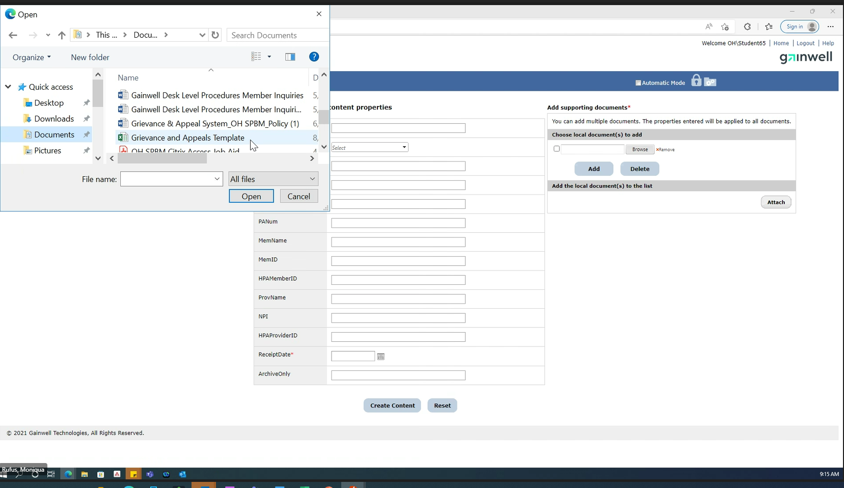
Click browse to bring up file text box.
Select the document from where you have saved it on your computer.
Select file and double click to put in File Name box.
Click Open
If additional documents are needed, click add to repeat the process.

Slide 14
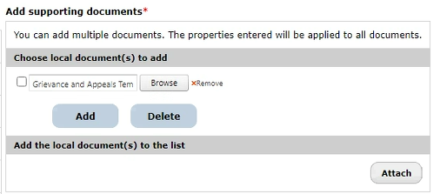
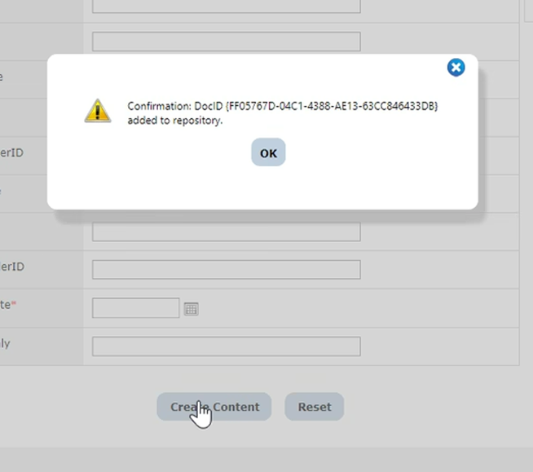
This is what it will look like when you click open. Next click attach.
Next click Create Content
Once you click Create Content you get the confirmation that the document was added to the repository (Case)

Slide 15
How to Search
A member calls in and wants to know the status of their grievance. The next slides will show the ways you can search and to see the status of the Grievance or Appeal

Slide 16
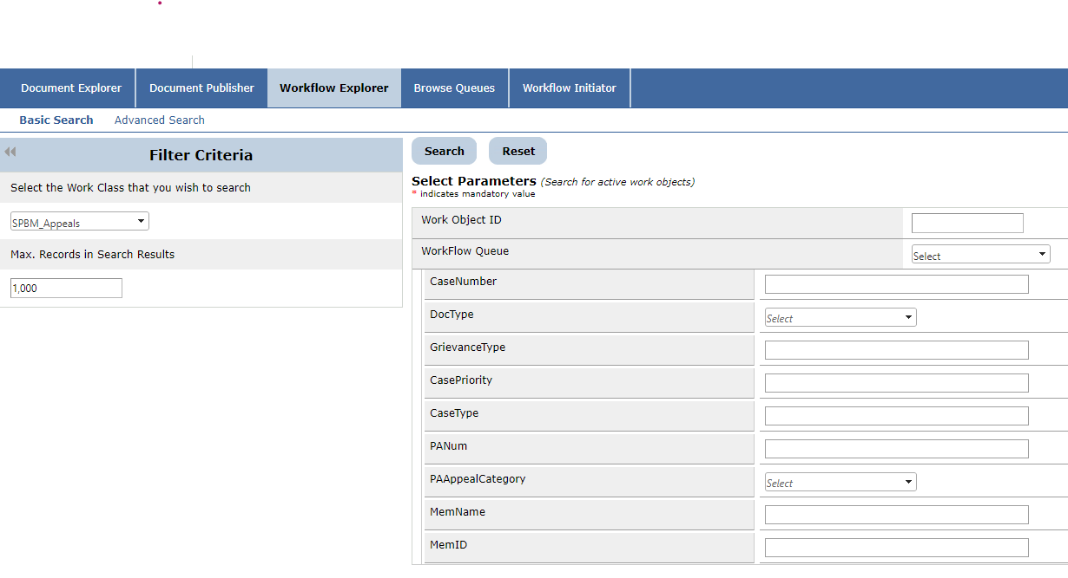
You can search in Workflow Explorer under case number, member name or member id

Slide 17
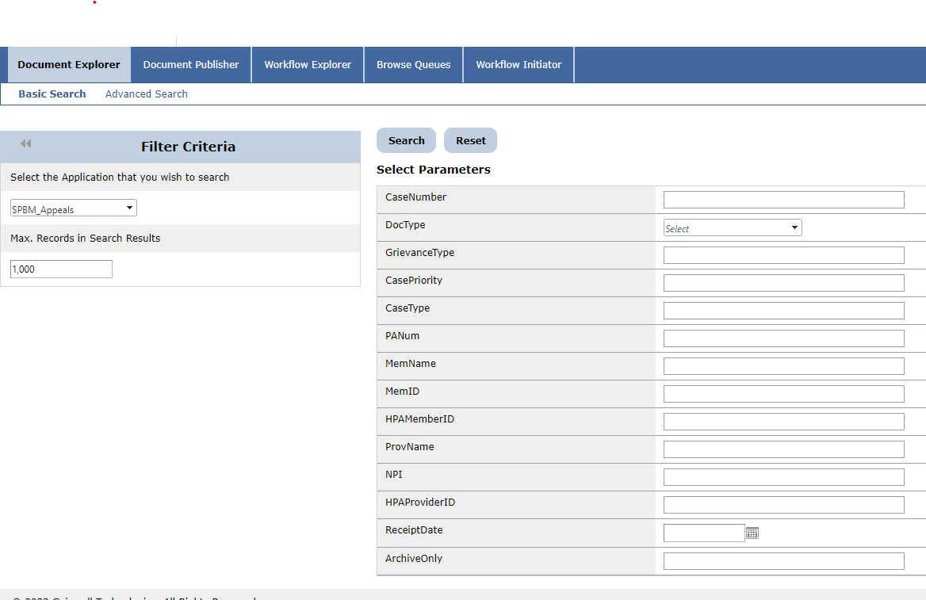
You can search in Document Explorer under case number, member name or member id

Slide 18
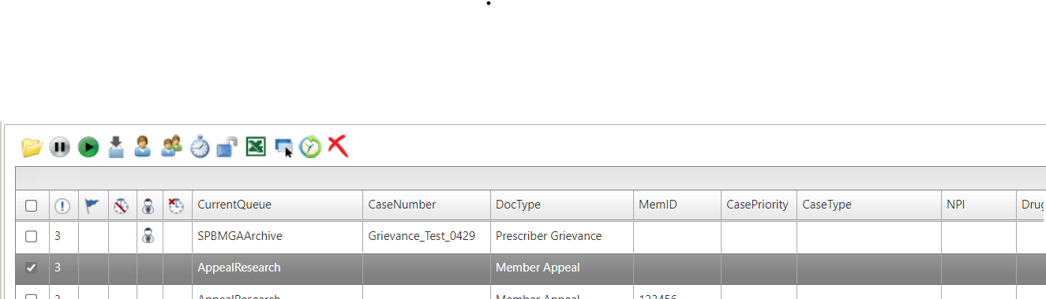
Once you find the case you want, put a check mark in the first box then click the yellow open file.
Note- The Current Queue field tells you where the case is housed at that point in time.

Slide 19
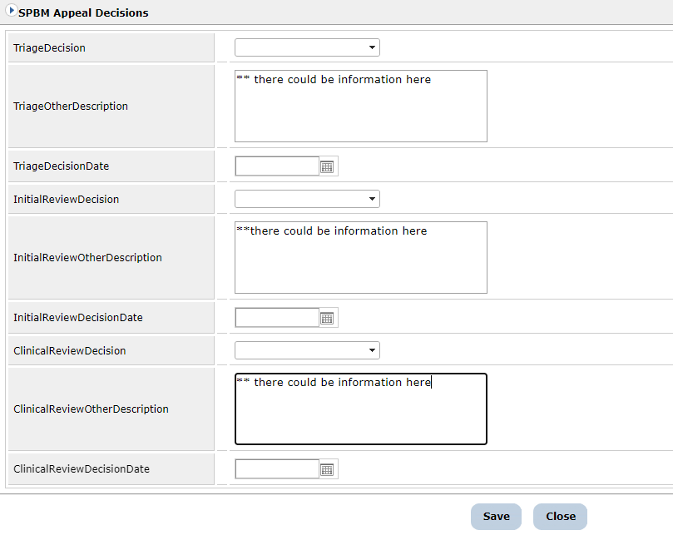
You can find information in these three boxes

Slide 20
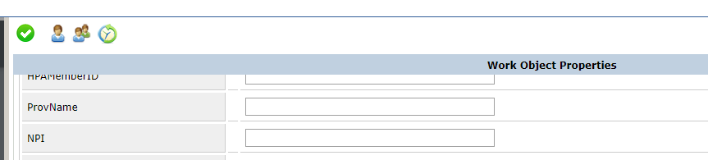
You can also look in history to see if there is any additional information. At the top of the page, you can click the green clock to take you to history

Slide 21
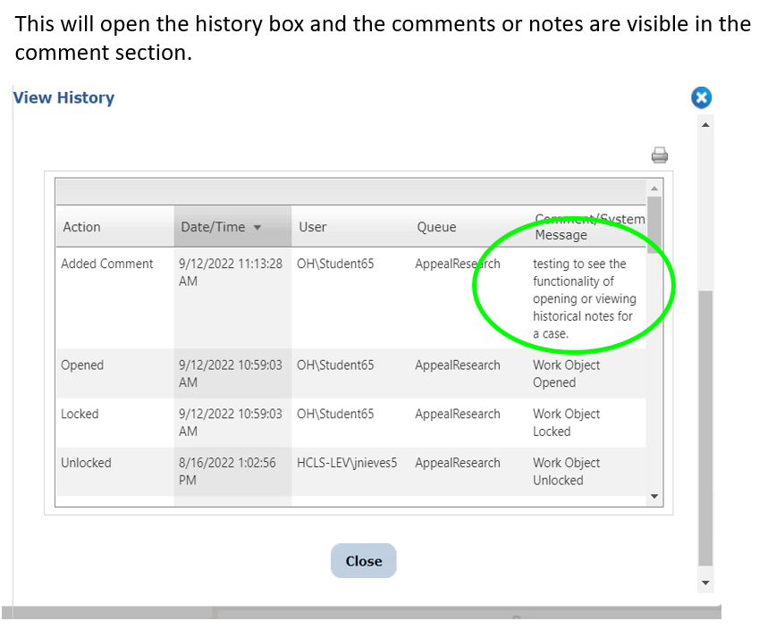
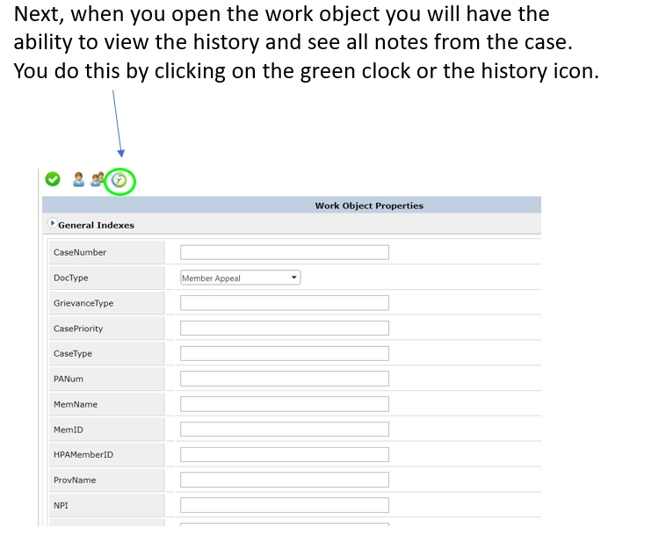

Slide 22


Slide 23
QUESTIONS??

